Slide 1
Radar Fundamentals
presented by:
Reham Mahmoud AbD El-fattah ali

Slide 2
What is Radar?
It is an object detection system that uses electromagnetic waves to identify the range ,altitude ,direction or speed of both moving and fixed objects such as aircrafts ,ships ,motor vehicles ,weather formations and terrain.
RADAR is an acronym for RAdio Detection And Ranging

Slide 3
Types of Radar?
Radars
Pulsed
Noncoherent
Coherent
CW
FMCW
Low PRF
Medium PRF
High PRF
CW = continuous wave
FMCW = frequency modulated continuous wave
PRF = pulse repetition frequency

Slide 4
What is Principle of Operation?
1- Reflection of electromagnetic waves
2-Measurement of running time of transmitted pulses

Slide 5
What is Principle of Measurement?
Distance Determination.
Direction Determination.
Elevation Angle.
Range Resolution.

Slide 6
1-Distance Determination:
Slant range: is the line of sight distance between the radar and the object illuminated.
R = c₀· t/2
where: c₀ = speed of light = 3·10^{8 m}/_{s} t = measured running time [s] R = slant range antenna - aim [m]
The distances are expressed in kilometers or nautical miles (1 NM =1.852 km)

Slide 7
2-Direction Determination
The angular determination of the target is determined by the directivity of the antenna.
Directivity, directive gain: is the ability of the antenna to concentrate the transmitted energy in a particular direction.

Slide 8
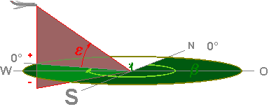
3-Elevation Angle
The elevation angle :is the angle between the horizontal plane and the line of sight, measured in the vertical plane. The Greek letter Epsilon (ε) describes the elevation angle

Slide 9
4-Range Resolution:
Range resolution : is the ability of a radar system to distinguish between two or more targets on the same bearing but at different ranges.
The degree of range resolution depends on the width of the transmitted pulse, the types and sizes of targets, and the efficiency of the receiver and indicator. Pulse width is the primary factor in range
resolution.
Δ R = R 2 − R 1 = c τ / 2 .
where: c₀ = speed of light = 3·10^{8 m}/_{s} τ = pulse width time

Slide 10
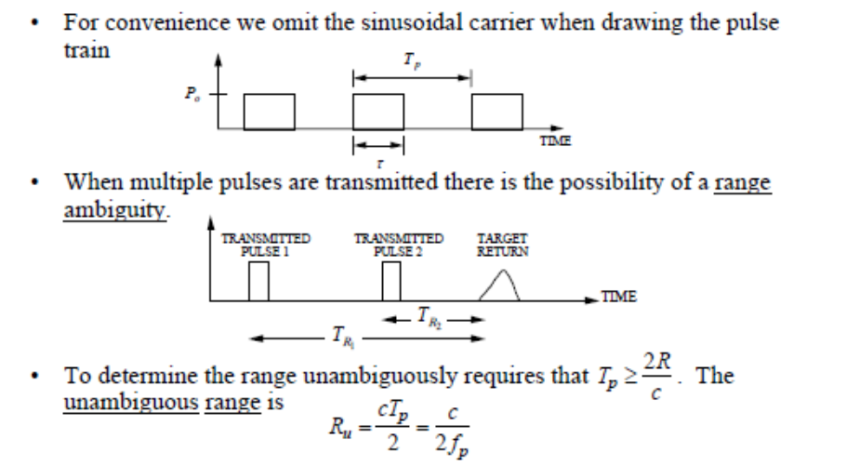
Range Ambiguities:

Slide 11
What are Radar Timing
Parameters?
Pulse Repetition Frequency.
Duty Cycle.
Dwell Time.

Slide 12
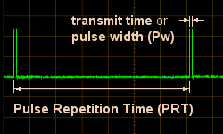
What is Pulse Repetition Frequency?
The Pulse Repetition Frequency (PRF) of the radar system is the number of pulses that are transmitted per second.

Slide 13
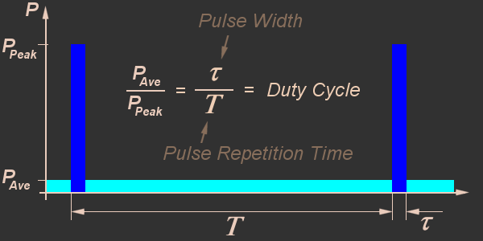
What is Duty Cycle?
Duty cycle is the proportion of time during which component, device, or system is operated.

Slide 14
What is Dwell Time?
The time that an antenna beam spends on a target is called dwell time T_{D}.
The dwell time of a 2D–search radar depends predominantly on:
1) the antennas horizontally beam width Θ_{AZ} and
2) the turn speed n of the antenna (rotations per minute).
The dwell time can be calculated using the following equation:
T_{D} = (Θ_{AZ} · 60)/(360° · n) ; in [seconds]
The number of pulses that will hit the target in this time is
nB = T_{D.} f p

Slide 15
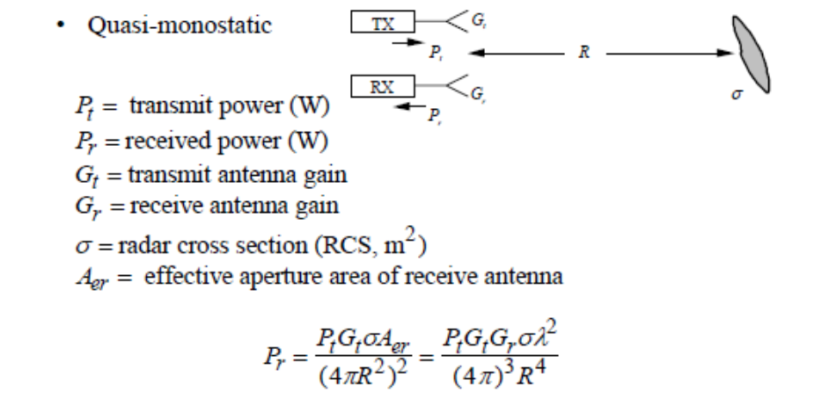
What is Radar Equation:

Slide 16
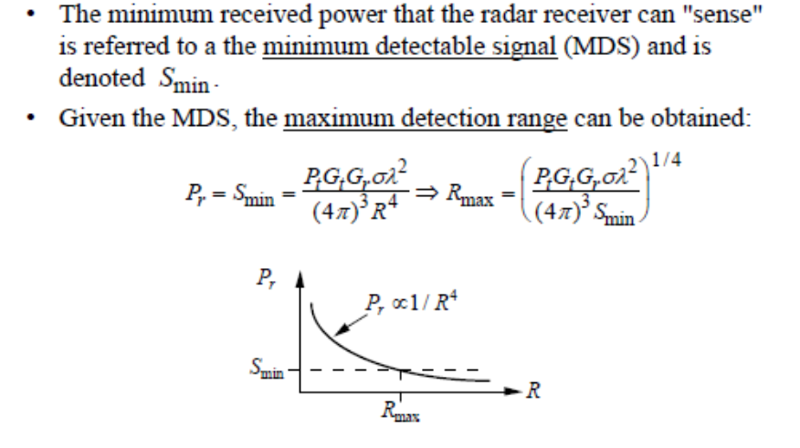
What is Maximum Detection Range?

Slide 17
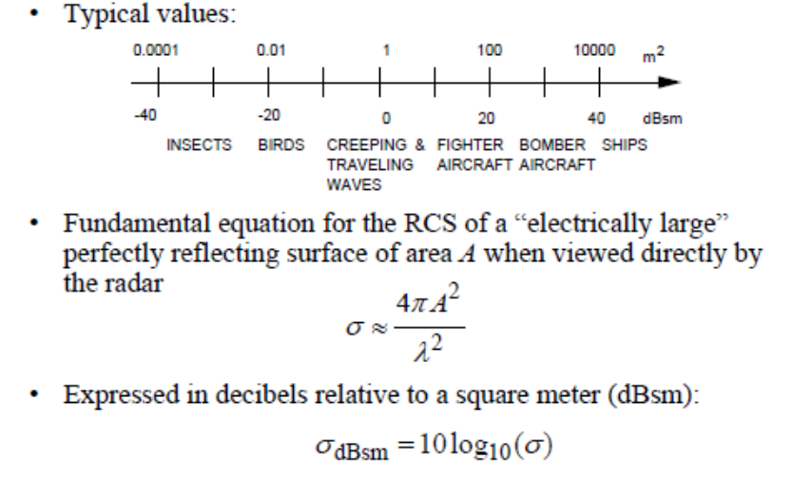
What is Radar Cross Section?

Slide 18
What are types of Interference?
Noise.
Clutter.
Jamming.

Slide 19
What is Noise?
Signal noise is an internal source of random variations in the signal, which is generated by all electronic components.
Noise is also generated by external sources, most importantly the natural thermal radiation of the background scene surrounding the target of interest.

Slide 20
Thermal Noise Power:

Slide 21
What is Signal-to-Noise Ratio (SNR)?

Slide 22
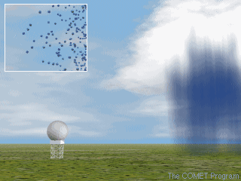
What is Clutter?
Radio frequency (RF) echoes returned from targets which are uninteresting to the radar operators.

Slide 23
What are types of Clutter?
The basic types of clutter can be summarized as follows:
1) Surface Clutter – Ground or sea returns are typical surface clutter.
2)
Volume Clutter – Weather or chaff are typical volume clutter.
3) Point Clutter – Birds, windmills and individual tall buildings are typical point
clutter and are not extended in nature.

Slide 24
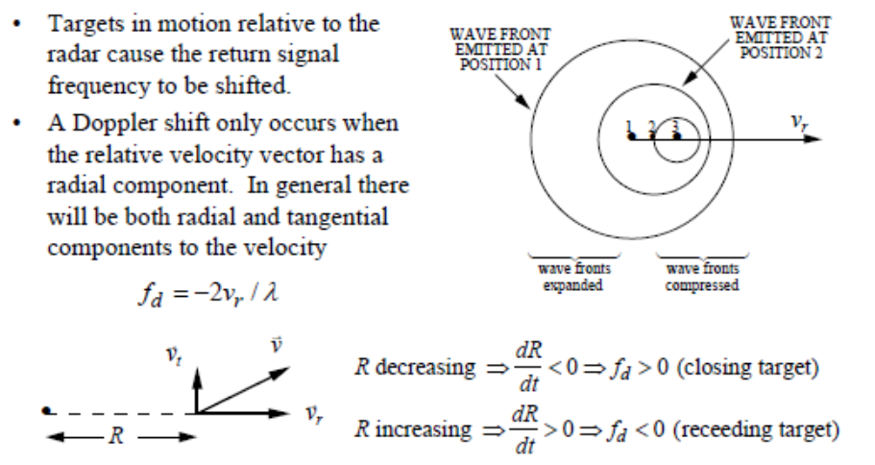
What is Doppler Shift?

Slide 25
What is Jamming?
Radio frequency signals originating from sources outside the radar, transmitting in the radar's frequency and thereby masking targets of interest.

